Slide 1
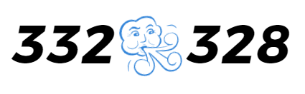
Functional Fan

Slide 2
CONTENTS
1
Introduction
2
Block Diagram
3
Hardware Resource, Timing
4
Additional Function
5
Demo Video

Slide 3
Introduction

Slide 4
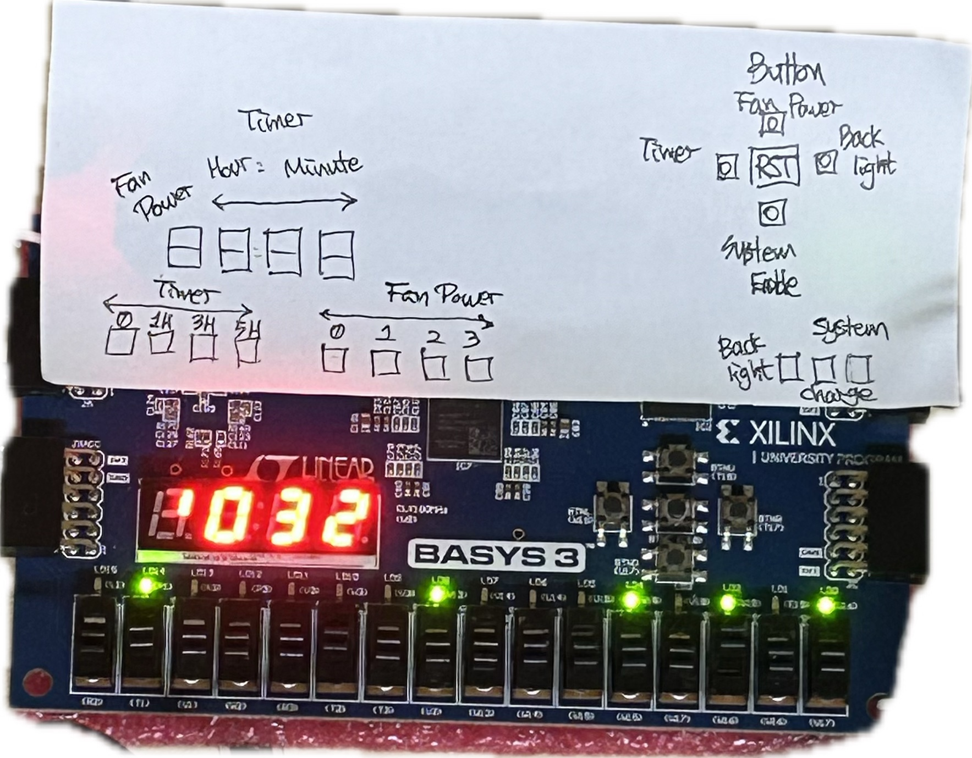
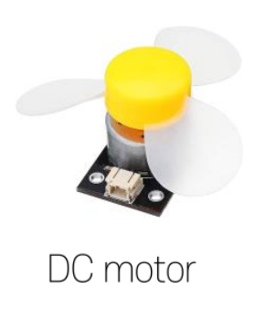
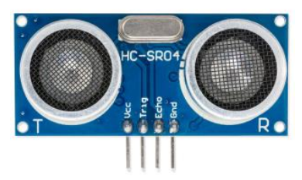
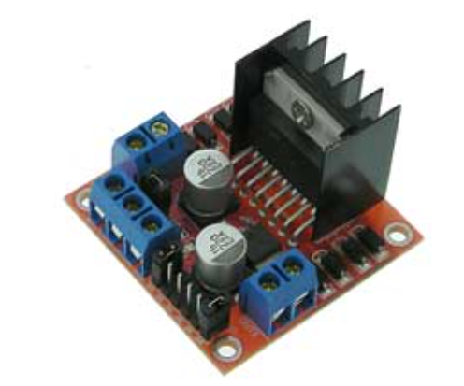
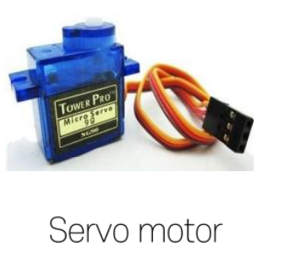
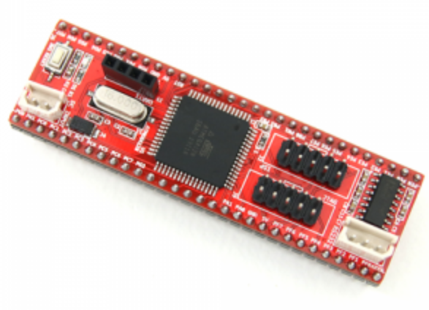
Overall Design
Up button => Power Control
LED[0] => Enable, LED[1] => Charge, LED[2] => Back light,
LED[7] => Power Off, LED[8] => Power Low,
LED[9] => Power Mid, LED[10] => Power Max
LED[12] => No SET, LED[13] => Set 1h, LED[14] => Set 3h, LED[15] => Set 5h
Left button => Timer Set (1h, 3h, 5h)
Right button => Back Light (it can adjust)
Bottom button => System Enable

Slide 5
https://cdn.discordapp.com/attachments/1255395223669047327/1262244835163639808/BD_functionalFan-Detailed_BD.drawio.png?ex=6695e49c&is=6694931c&hm=a9c0640ca261881455efc3bfda5f869e745847d4066a03d9041da414c1e887c2&
Reference BD
Notes:
https://cdn.discordapp.com/attachments/1255395223669047327/1262222594438860960/BD_functionalFan-Detailed_BD.drawio.png?ex=6695cfe5&is=66947e65&hm=5eda5052bbd902ea161da470f5427a1967c47bd553419a9114e0aa3591b2040f&

Slide 6
Block Diagram

Slide 7
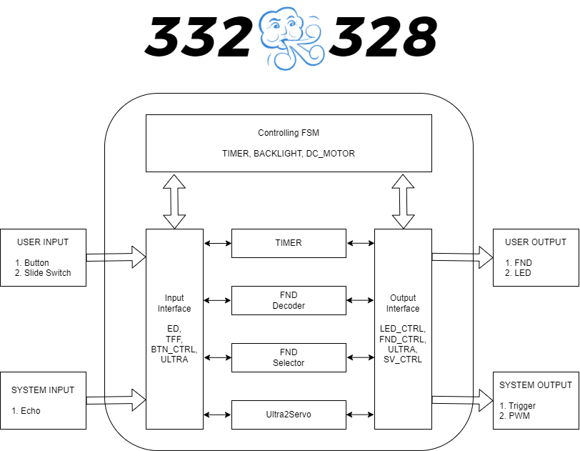
Block Diagram

Slide 8
Hardware Resource

Slide 9
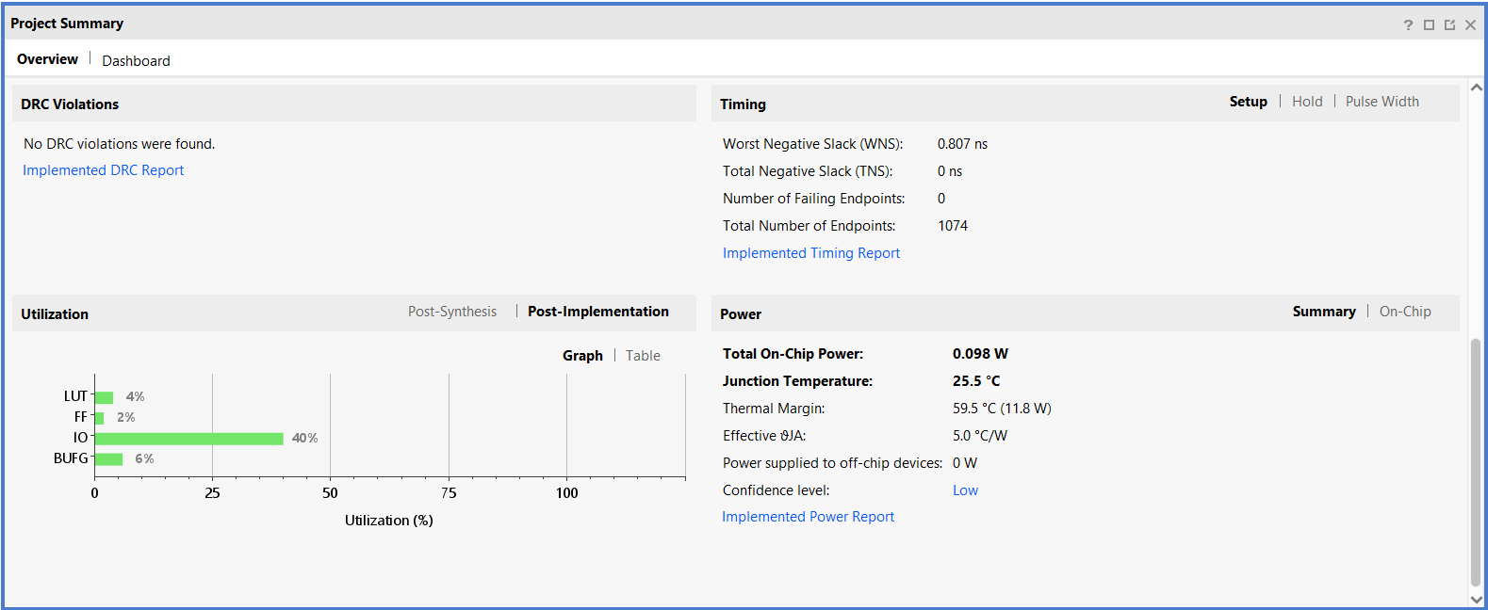
Hardware Resource

Slide 10
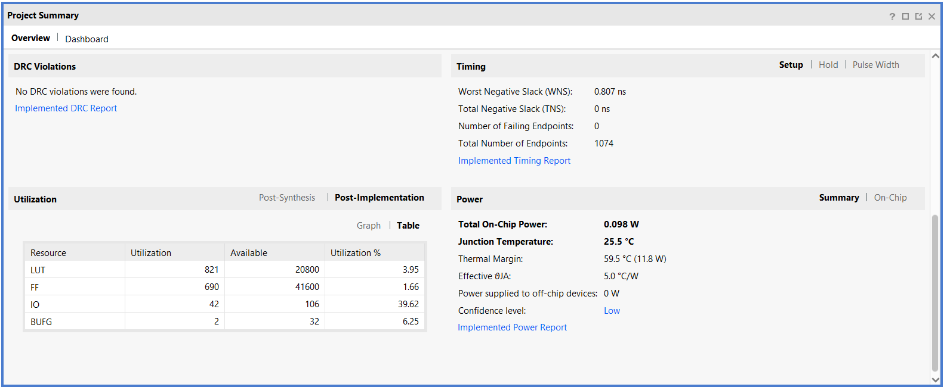
Hardware Resource
Notes:
sonic 많이 쓸수록 lut많이 씀, 5개의 각을 제어하기 위해서 안정적으로 5개의 소닉이 필요한데, hardware utilize를 높이기 위해서 3개로 5개의 각을 감지할 수 있는 idea를 고려했다

Slide 11
Additional Function

Slide 12
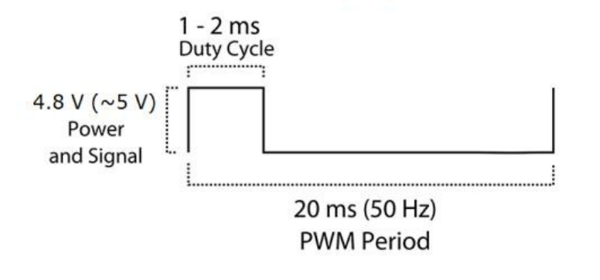
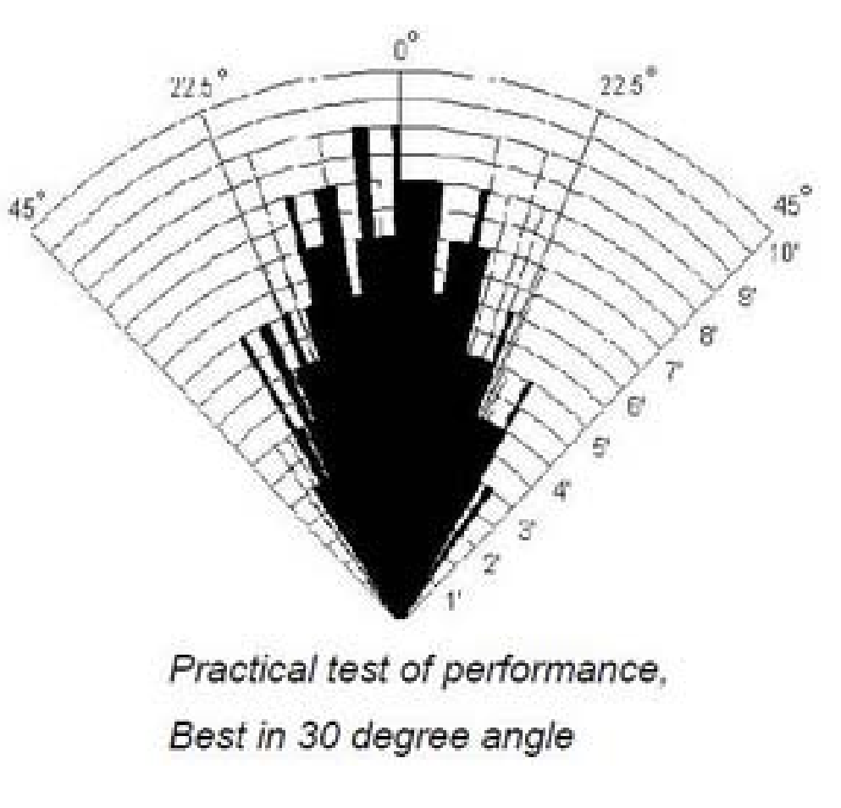
Additional Function – Tracking Fan
We want to adjust by 1 degree increments, so we set it to 12-bit steps.
The servo motor will move when the PWM period is between 5% and 10%.
The step range for -90 to 90 degrees should be 205 to 410, but in our experiments, it was 102 to 510.
Servo motor duty cycle description
And we also figured out the working range of the ultrasonic sensor.
Ideal degree of ultrasonic sensor

Slide 13
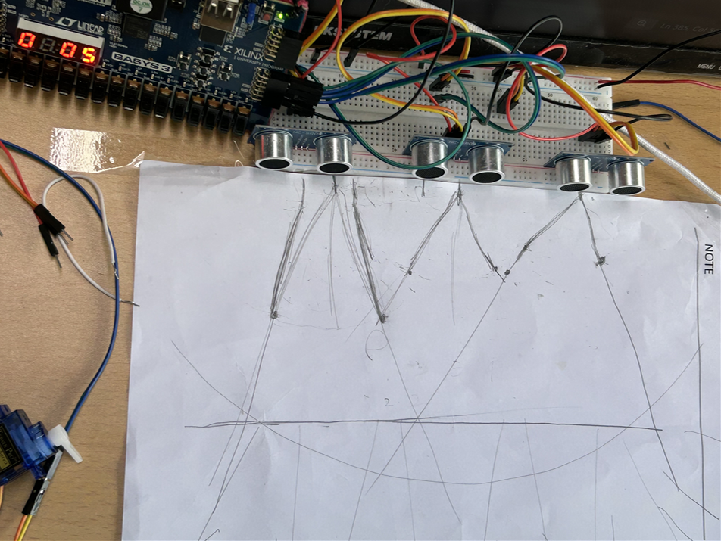
Additional Function – Tracking Fan

Slide 14
Tracking Fan – (One Hot Encoding)
1
2
3
Servo duty 102 307 510

Slide 15
Tracking Fan – (3-5 mode)
1
3
5
2
4

Slide 16
Demo Video
https://youtube.com/watch/lhrXHiQR6Ao?feature=share
Complete functionality video
https://youtube.com/watch/Jepbu6V5jWs?feature=share
3-5 mode

Slide 17
Q&A

